Slide 1
All About Mrs. Bailey!
Welcome to English I

Slide 2
The Beginning.
Was born on November 6, 1989 in Statesville, NC. (About an hour away from Charlotte)
Middle child and only girl. I have an older brother, Josh. Younger brother, Dylan.
Parents are Debbie and Doug McLain.

Slide 3
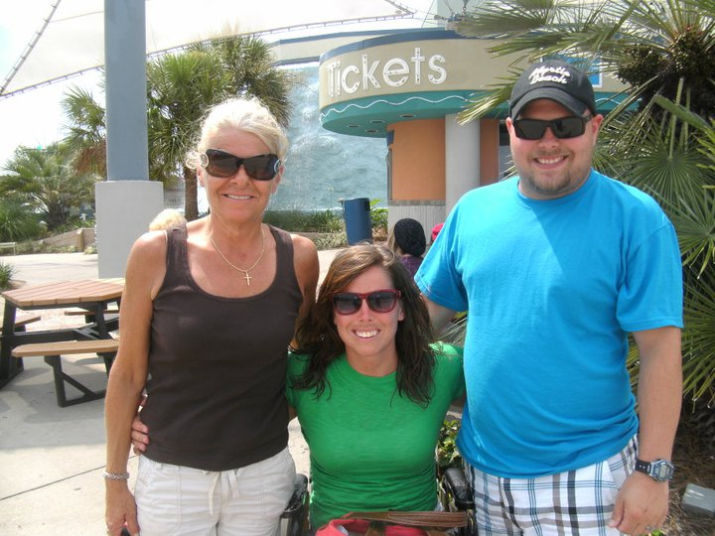
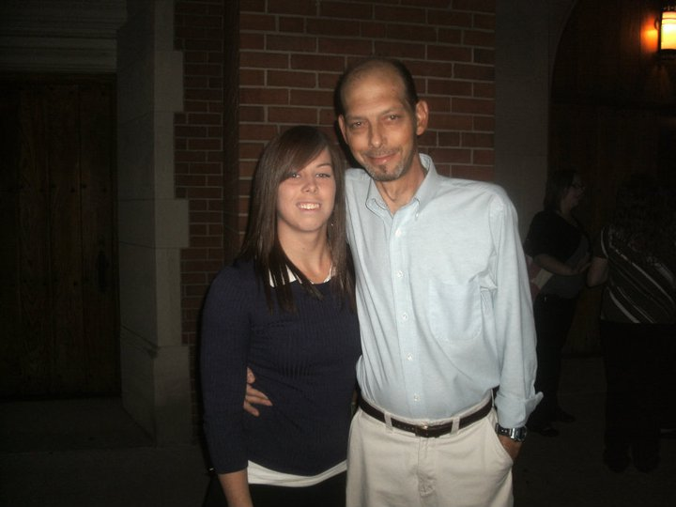
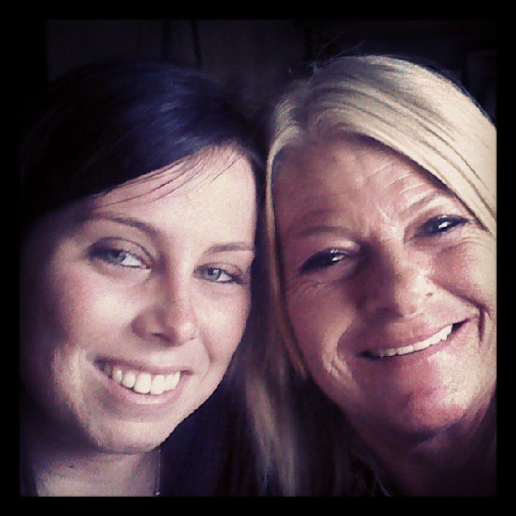
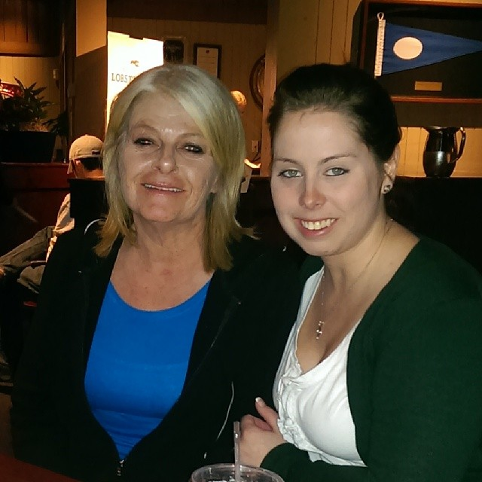
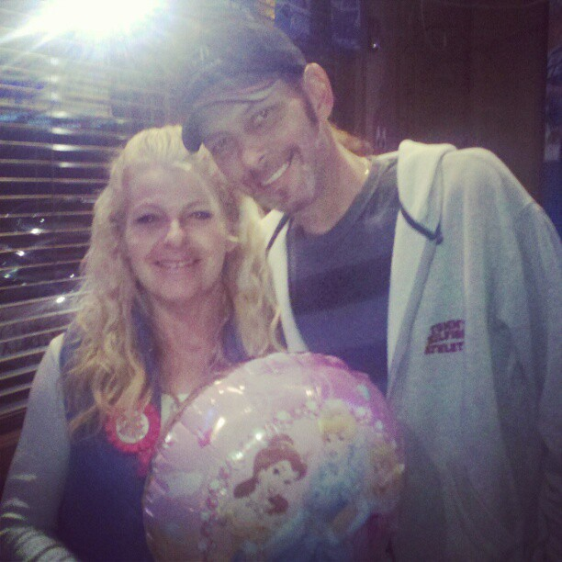
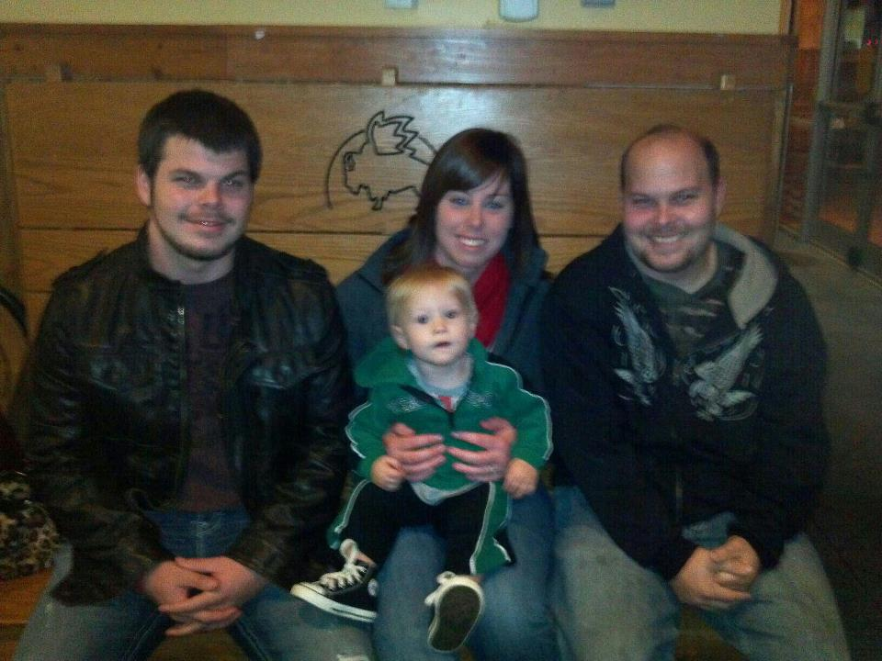
My immediate family- The McLain’s

Slide 4
The details
Dad had 4 back operations, Lyme’s Disease, etc. Mom was the only one that worked. Money was limited.
At age 13, I was hit by a car while riding a 4-wheeler. This happened 11-28-02. I lost my leg on 12-8-02.
8 years later, on my wedding day, the remaining limb broke. I had more amputation a month after my wedding.
Sometimes I will come to work in my chair, sometimes I will wear my leg. If you have any questions- just ask! I would rather you ask than look at me funny.

Slide 5
School
Graduated at the top of my class from West Iredell in 2008.
Graduated from Catawba College in Salisbury, NC in December 2012.
Doctors (some) said I would never walk again, never graduate from high school. However, I made it through college without any financial help from my parents. (They did not have it.)

Slide 6
MY FAMILY!
Started dating my husband, Daniel, his senior year of high school 1-16-09. I was a year older.
He proposed in September, 2009. (His first year of college, my second)
We were married on April 18, 2010.
It will be 5 years this April!
We have A FUR BABY- Chewbacca. He is a “Boxador” Boxer/Lab mix. He is spoiled rotten.
Daniel is a soccer player, going to school for his degree in engineering, and works for NASCAR (tire specialist). (You will probably see him around sometimes helping me).

Slide 7
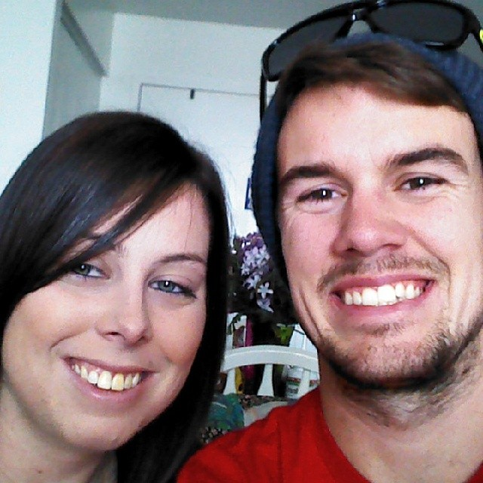
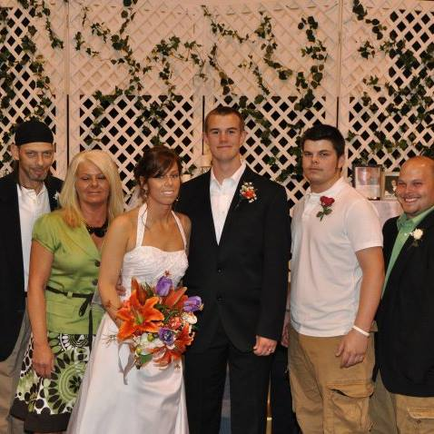
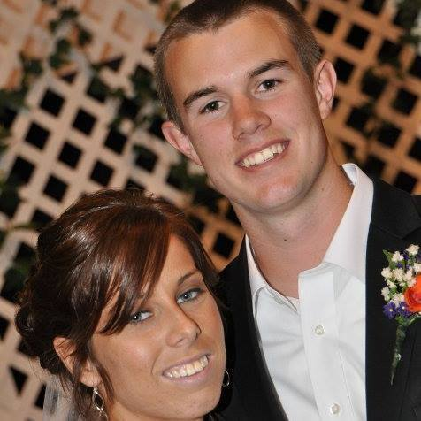
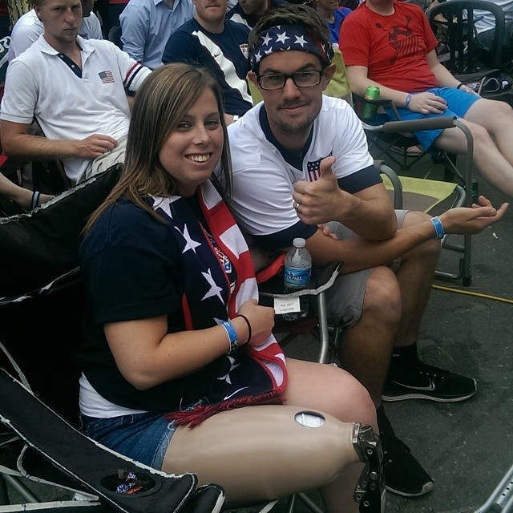
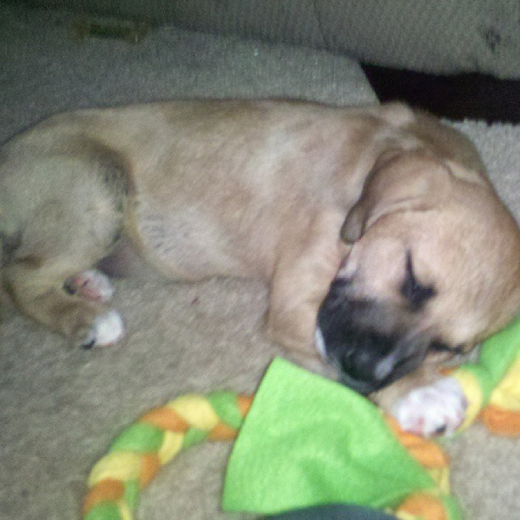
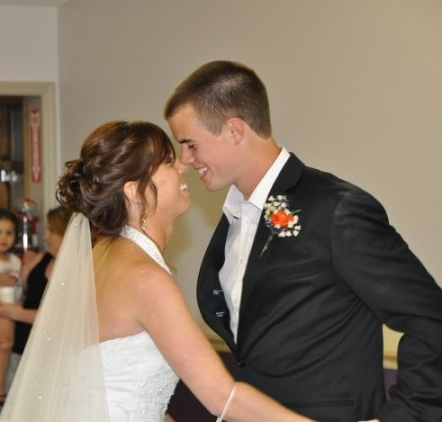
My Family! The Bailey’s

Slide 8
Mrs. Bailey’s Fast Facts
My father passed away on May 1, 2011. I miss him very dearly!
I LOVE to read- the book is ALWAYS better than the movie.
I enjoy watching college basketball- GO HEELS!
I also like soccer- Chelsea FC & USA National teams.
Krispy Kreme is my favorite.
I traveled to Florida (First time) to Universal Studios & Islands of Adventure- I WENT TO HARRY POTTER WORLD! (this summer).

Slide 9
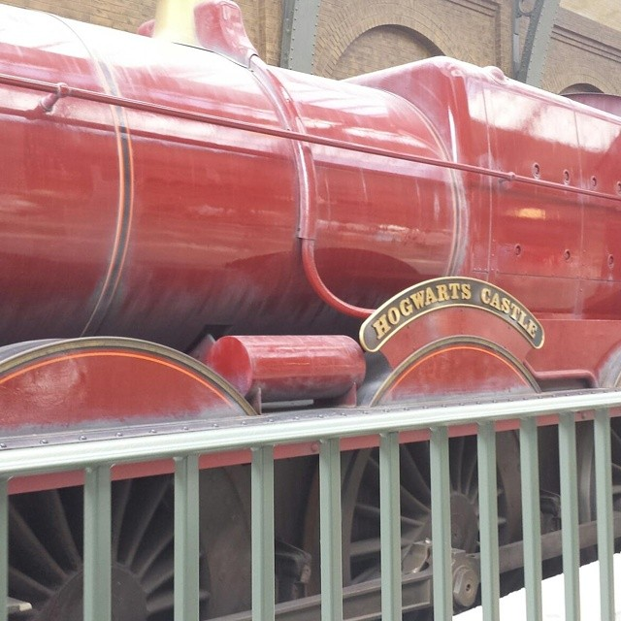
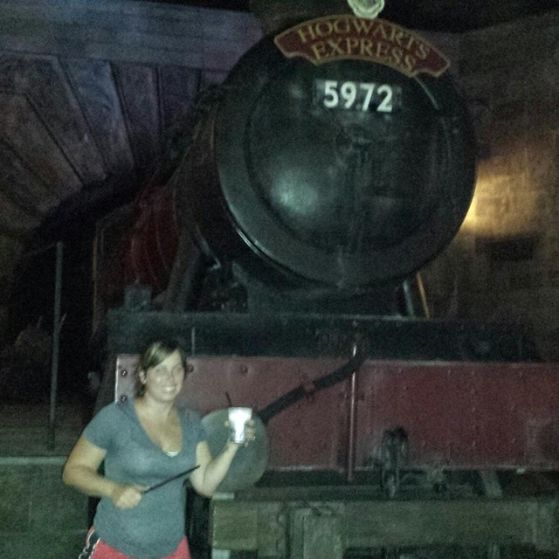
My BEST TRIP EVER!

Slide 10
Finally.
I look forward to meeting and getting to know each and every one of you!
Let’s make this year AWESOME!

